Slide 1
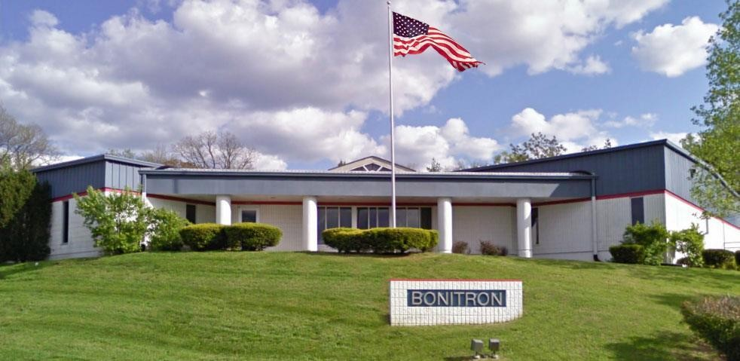
Bonitron, Inc.
Dedicated to engineering quality industrial electronics since 1962!
20141103

Slide 2
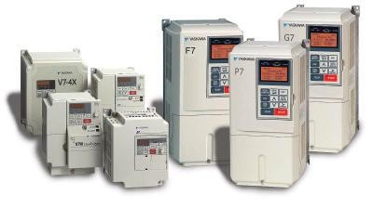
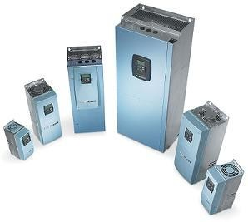
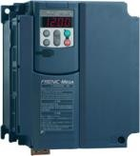
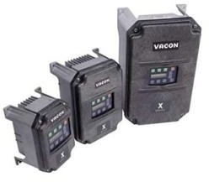
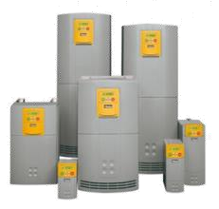
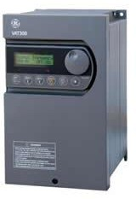
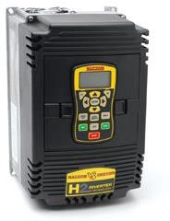
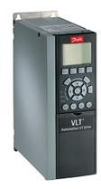
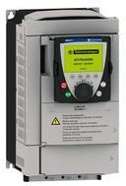
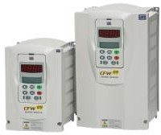
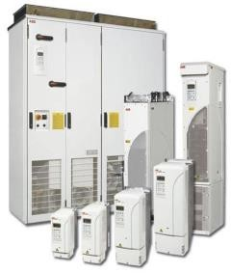
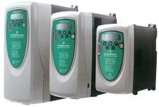
Power Quality Problems with VFD’s
Drive “Ride Thru” Capabilities
VFD DC Bus Capacitors Drain Almost Immediately
No Sag Correction Built In
6 Pulse Front Ends Have No Boost Capability
Maintaining Full Load And Power
Kinetic Buffering Causes Speed And Torque Changes
Utility Power Outages
Returning Utility Power Or Input AC Can Cause Surges
5

Slide 3
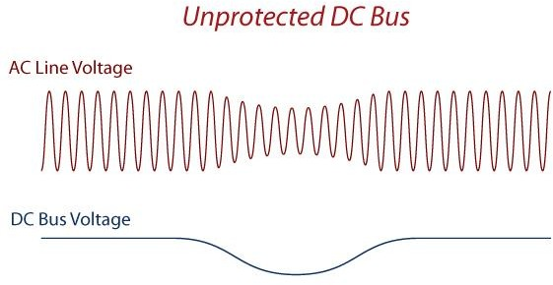
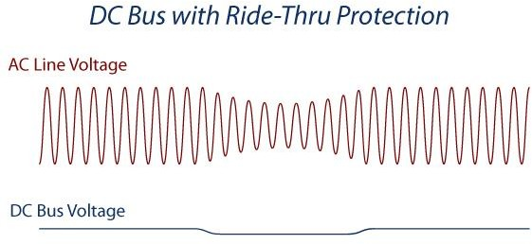
Understanding Ride-Thru
Bonitron UPD Ride-Thru systems are designed for AC drive systems that use a fixed DC bus, such as AC variable speed drives (VSD). Unfortunately, VSDs are quite susceptible to fluctuations in incoming AC line power, such as voltage sags and complete outages from the utility. Bonitron UPD Ride-Thru systems provide the security of “riding through” these events by holding up a drives DC bus allowing for motor constant speed and torque.

Slide 4
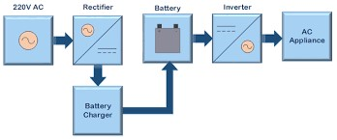
Current Industry Ride Thru Solutions
Online UPS
Line Interactive UPS
Standby UPS
AC Line Sag Corrector
Flywheels
VFD Active Front Ends
Excessive Energy Used During Normal Operation Due to Passing All AC Power to VFD Input.
For Non-critical Applications. Lowest Level of UPS Protection
Corrects for Sags and Partial AC Line Losses. No Full Outage Capability
Becomes Active and Uses Batteries with AC Line Momentary Brownouts.
Series Solution. Point of Failure During Normal Operation
Inverter Only Operatives as Long as The Outage Event Lasts and Batteries Remain Charged.
During Normal Operation, Outputs a Square Wave Creating Excessive Wear and Tear on Associated Motors
Series Solution. Supplies All AC Line Voltage. Point of Failure During Normal Operation
Most of The Units Available Have to Switch to Battery Momentarily When Making Transformer Voltage Adjustments During Brownouts, Which Reduce Battery Life Over Time
Bearing Changeouts Create Excessive Downtime
Requires Batteries for Storing Flywheel Energy
Cycles of Ride Thru Only. Can Not Handle Extended Outage Ride Thru Specifications
Has A Voltage Regulating Transformer For Low Voltage “Brownout” Events
Series Ride Thru Solutions
Series VFD AC Input Ride Thru Solutions
AC Utility Input
Rectifier
Batteries
UPS AC Output to VFD
VFD
AC Line Utility/UPS VFD Input. UPD AC 3 Phase Output to Drive
Charger
Online Double Conversion UPS

Slide 5
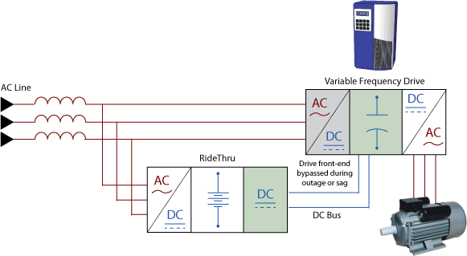
Uninterruptible Power for Drives
UPD Advantages

Slide 6
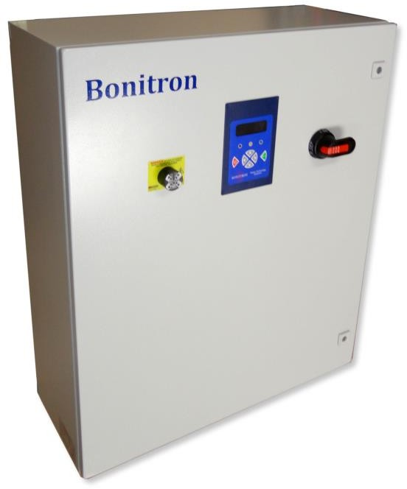
Bonitron UPD Advantages
Maintains Speed and Torque for Critical Applications
During an AC Line Sag or Outage, Critical Application VFDs Remain at Full Capability
Simple Retrofit or Initial Installation
Uses Drive’s Existing DC Bus Connection Terminals
Non-intrusive to Variable Frequency Drive: WARRANTY SAFE
Increased Reliability
Parallel Configuration to Drive
Local to Drive Installation Protects From External and Internal Plant Grid Faults
Increased Efficiency
In Parallel Standby Mode, Bonitron UPD Systems and Modules Use Less Static Power Than On-line Series Drive Backups
Higher Efficiency During Backup, Longer Durations From Energy Storage
Storage Options
VRLA Battery Banks Are Sized to The Specific AC Line Outage kW Requirement and Time Required
Shorter AC Line 100% Outage Times Can Use Maintenance Free Ultracapacitor Energy Storage
1100

Slide 7
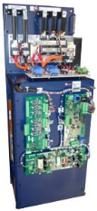
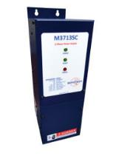
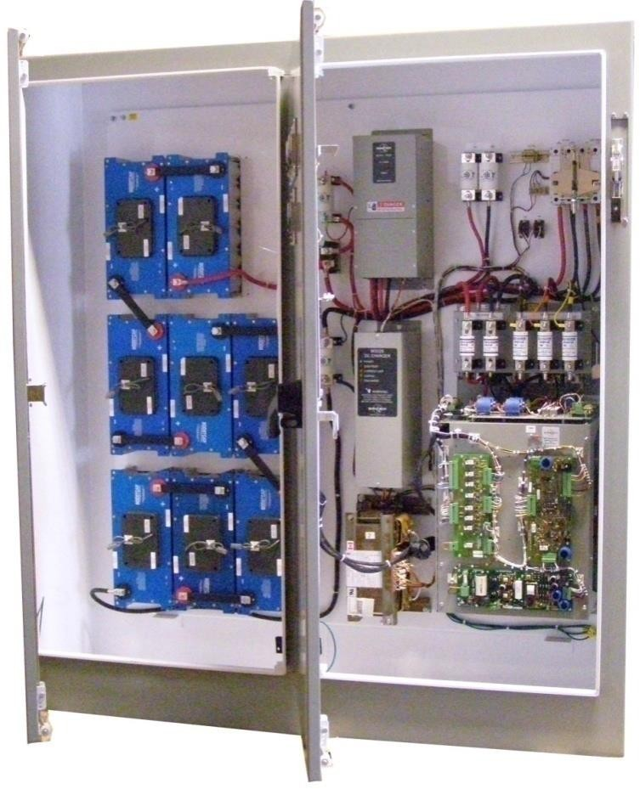
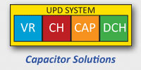
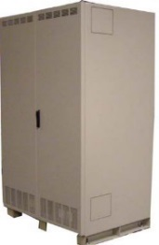
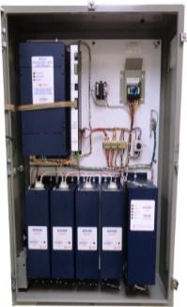
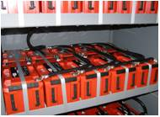
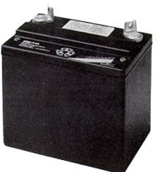
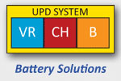
Bonitron Uninterruptable Power For Drives
UPD Systems & Modules
AC-DC Conversion Single Voltage Regulator Booster - Sags
DC-DC Conversion Voltage Regulator Booster with Energy Storage and Charger – 100% Outages
50% Sags, 100% Single Phase Outage
Single Unit Required Only
No Energy Storage Necessary
0.5-2 Seconds 100% AC Line Outage
Bonitron Voltage Booster M3460R
Charging System
Ultracapacitor Energy Storage
Ultracapacitor Safety Discharge
Voltage Regulator Booster Only
Short Term AC Line Outages
Long Term AC Line Outages
3 Seconds to 30 Minutes,
Energy Storage Ultracapacitors or Batteries, Time and kW Dependent
3-15 Seconds, Energy Storage, kW Dependent with M3460B
Bonitron Voltage Booster M3460B
Charging System
Battery Energy Storage

Slide 8
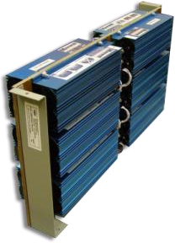
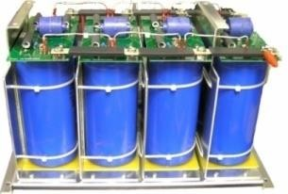
Energy Storage Options
Batteries
Ultracapacitors
Electrolytic Capacitors
12V VRLA Battery
Up to 15 minute full outage
Long Term Outages
Low to High kW Drives
180V Module
48V Module
Short Term Outages
Low to High kW Drives
700V Assembly
Short Term Outages
Low kW Drives
15

Slide 9
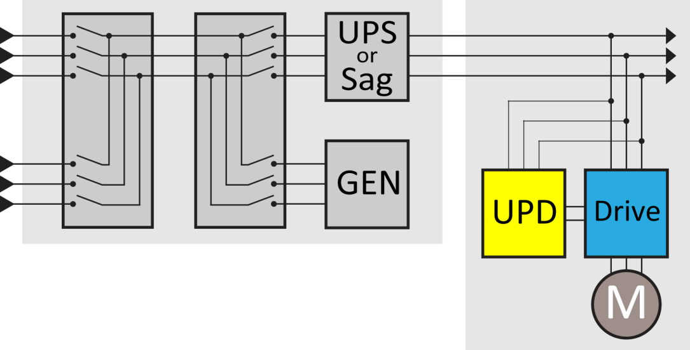
Critical Process Protection
Plant Redundancy
Power Distribution UPS
Process Level VFD Backup
Plant Gen Set
Plant Backup Systems & Redundancy
Solution selection is usually dependent on the critical nature of an application. In critical applications, several levels of plant process and drive/motor protection are required. “Redundancy Levels”.
This is common in applications such as Semiconductor and Data Center HVAC VFD Systems where no change in speed or torque of the associated motor can occur. The drawing illustrates N+3 Redundancy

Slide 10
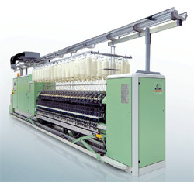
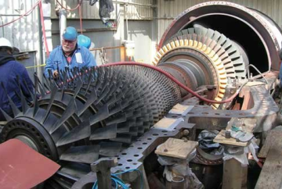
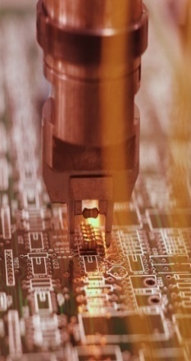
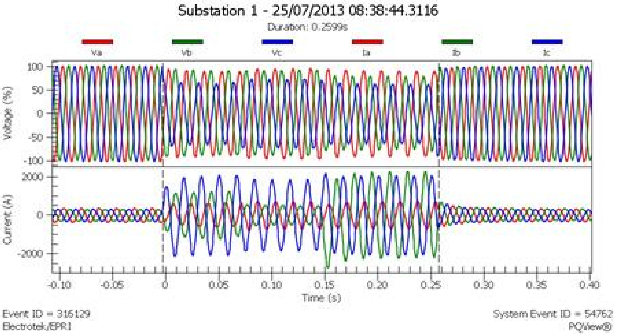
Critical Process Protection
What is a Critical Process?
Critical Process Backup Reasons
Personnel Safety Can Be Compromised if the Associated Process Motor Losses Power and Becomes Erratic
Critical Process Examples
Semiconductor – Cleanroom Air Handlers & Machine Tool Chill Water
Lubrication Systems
Safety Systems
Security Gates
Loss of Security System Power Can Allow Intrusion Into High Security Areas
Loss of Power to Equipment’s Personnel Safety Features Can Create Hazzard to Workers
Hoists & Cranes Can Drop Load
Power to Security Access Areas is Cut During Breach Attempts
Robotics Multi Axis Systems Lose Reference Causing Damage to Mechanical Components or Surrounding Equipment
High Speed Turbines Can Burn up Without Constant Lubrication
Cleans Rooms Must Remain Free of Environmental Particulates or Expensive Semiconductor Wafers are Discarded
Machine Tools for Wafer Etching Must maintain Constant Chill Water Cooling Due to High-Speed Operation
Any Slight Deviation in Motor Speed or Torque Can Create Scrap Product and Expensive Production Loses or Cleanup
Critical Data Can Be Lost if Environmental Systems Are Lost and Data Servers Overheat
Chemical and Toxic Exhaust Ventilation
Loss of Ventilation and Exhaust Fans can Create Personnel Hazzard from Toxic Gases
Perishable Products can Be Lost During AC Line Loss that Can Trip Refrigeration Compressor VFDs/Motors
Data Centers – Environmental Systems Backup

Slide 11
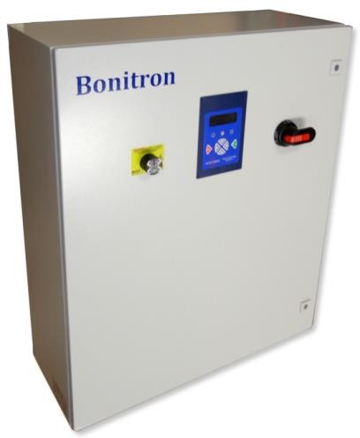
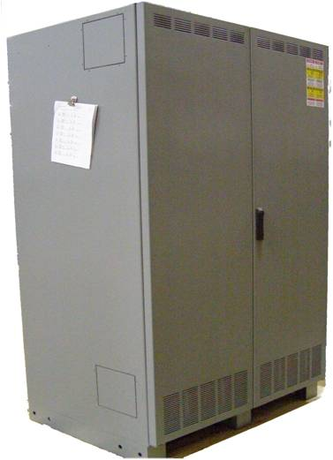
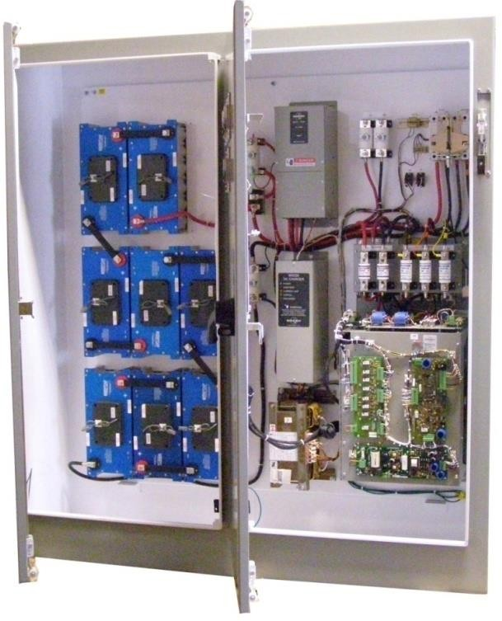
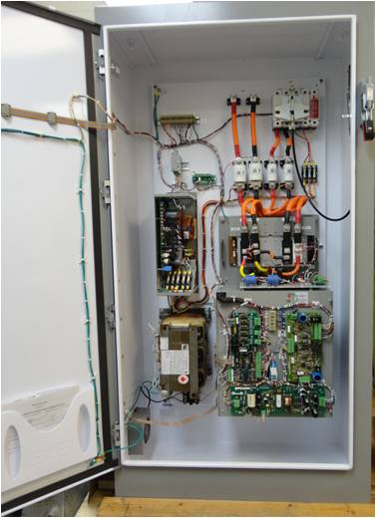
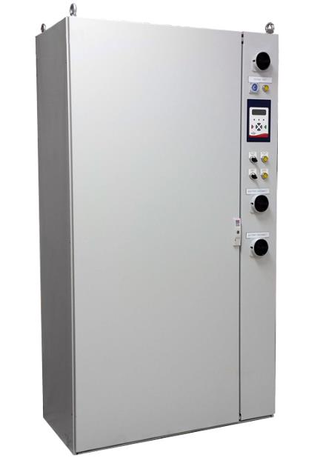
Bonitron UPD Systems
1-Second 100% Outage, 60kW Ultracapacitor Energy Storage
1-Second 100% Outage, 150kW, Double Bay Enclosure with Ultracapacitor Energy Storage
4 Minutes 100% Outage, 200kW and Battery Energy Storage Enclosure
2-Second 50% Sags, 250kW
15-Seconds, 230VAC 100%
Outage, 30kW Battery Energy Storage
2244

Slide 12
Dedicated to Designing and Manufacturing
Quality Industrial Electronics

